Slide 1
Human resource management system
By.,
Nitish M.P (1005189)
Preetham L (0998716)
Sumantha D.S (0995069)

Slide 2
Human Resource Management System => states to systems and processes at the intersection between Human Resource Management and information technology.
Our project => companies database => details of employee and => keep track => update or delete.
To perform any action there will be a security check, and the performed action’s will be stored in the file system.

Slide 3
ADVANTAGES OF PROPOSED SYSTEM
Very fast and accurate.
No necessity of more physical effort.
No passion of data loss
Little information to operate the system
Doesn’t require any extra hardware device.
At last very easy to find the employee information

Slide 4
SYSTEM REQUIREMENTS
System requirements:
Language: C++
Storage based: file
OS: Windows
RAM : 256MB

Slide 5
SYSTEM REQUIREMENTS cont.,
Hard ware Specification :
Processor: Intel p-III based system
Processor speed: 250 to 833Mhz
RAM: 64 to 256MB
Hard disk: 2GB to 30GB
Key board: 104keys

Slide 6
UML DIAGRAMS
Unified Modeling Language => International standard notation => object-oriented analysis and design
The UML is a language for
Visualizing
Specifying
Constructing
Documenting

Slide 7
MAJOR ELEMENTS OF UML DIAGRAMS
UML’s basic building blocks
The rules that dictate how those building blocks may be put together.
Some common mechanisms that apply throughout the UML

Slide 8
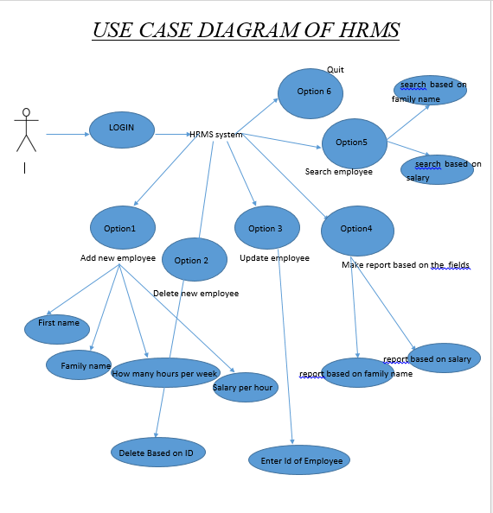
HRMS UML DIAGRAM

Slide 9
DESIGN PATTERNS USED IN THE PROJECT
The design patterns used in the project are Singleton, Prototype and Bridge design patterns.
We have used Singleton Design Pattern because it ensures a class has only one instance, and provides a global point of access to it and Encapsulates "just-in-time initialization" or "initialization on first use“.
Prototype Design Pattern is used because it specifies the kinds of objects to create using a prototypical
instance, and create new objects by copying this prototype which makes our work easier and Co-opt one
instance of a class for use as a breeder of all future instances.
Builder Design Pattern is used because it decouples an abstraction from its implementation so that the two can vary
independently and also publishes an interface in an inheritance hierarchy, and bury implementation in its own inheritance
hierarchy, it is also beyond encapsulation to insulation.

Slide 10
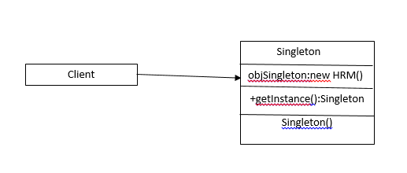
UML FOR Singleton design pattern

Slide 11
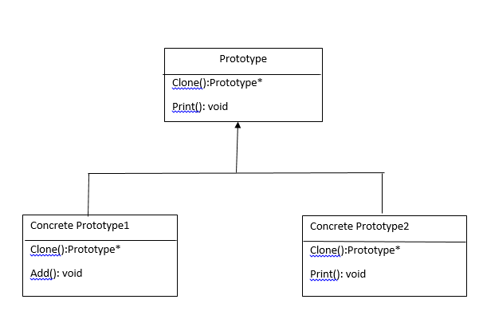
UML FOR PROTOTYPE design pattern

Slide 12
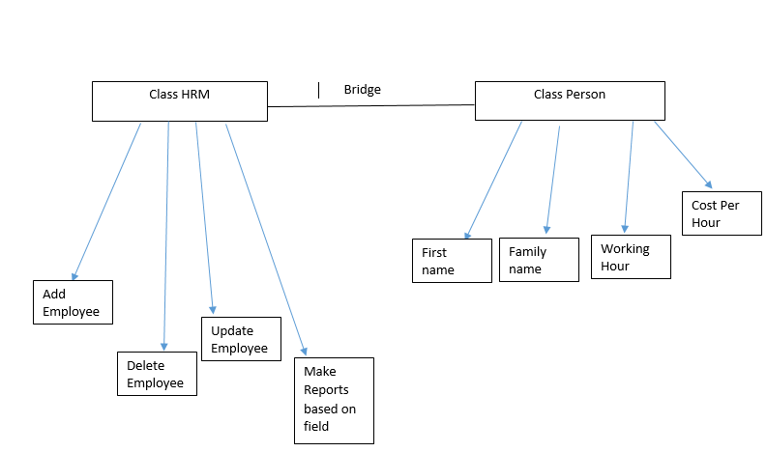
UML FOR Bridge design pattern

Slide 13
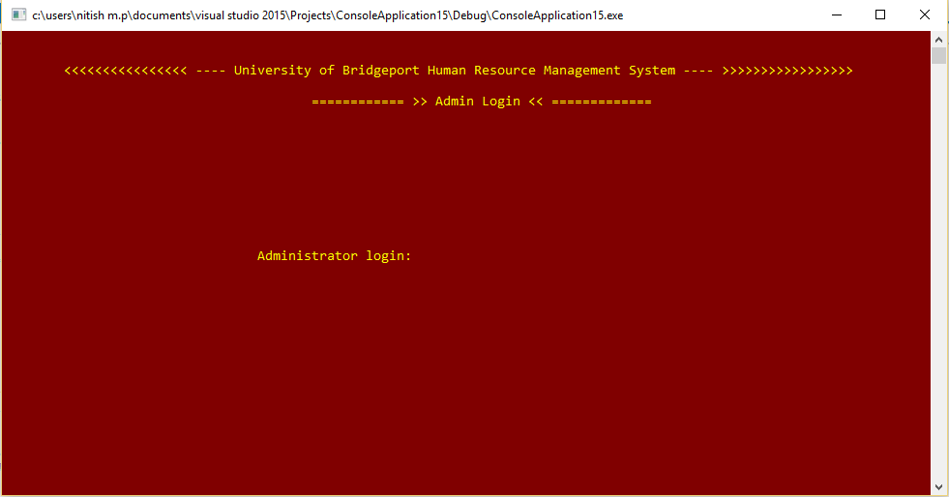
OUTPUT SCREEN SHOT

Slide 14
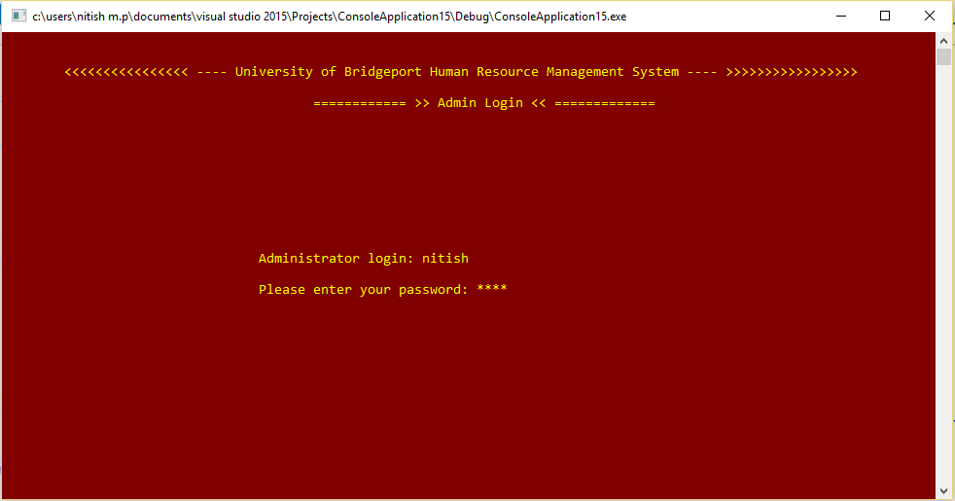
OUTPUT SCREEN SHOT CONT.,

Slide 15
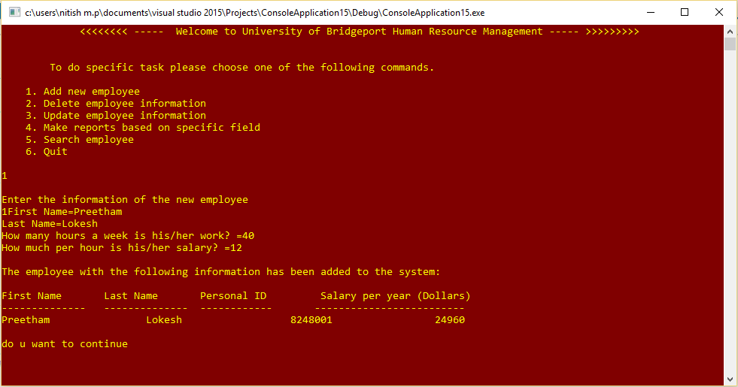
OUTPUT SCREEN SHOT CONT.,

Slide 16
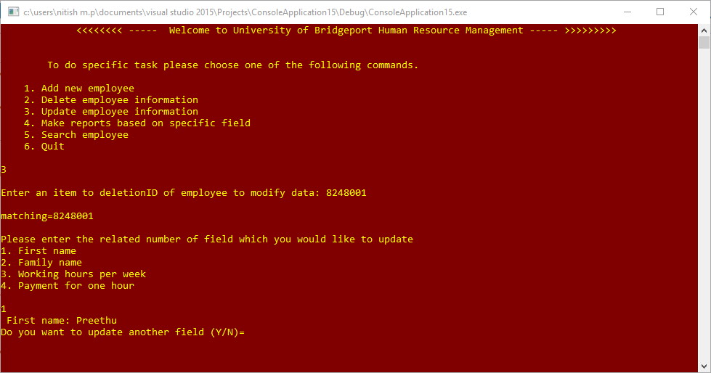
OUTPUT SCREEN SHOT CONT.,

Slide 17
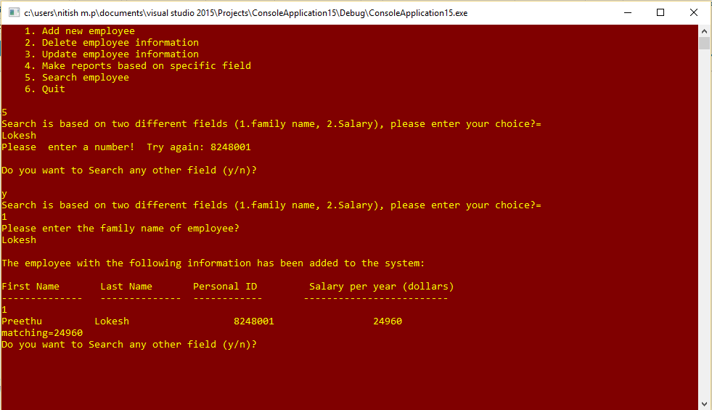
OUTPUT SCREEN SHOT CONT.,

Slide 18
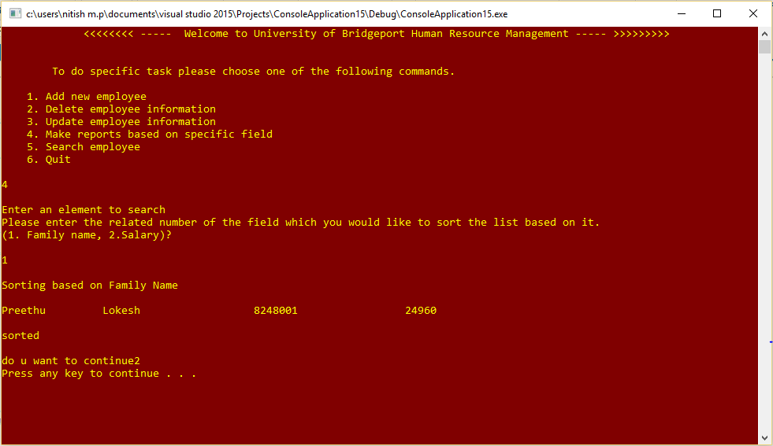
OUTPUT SCREEN SHOT CONT.,

Slide 19
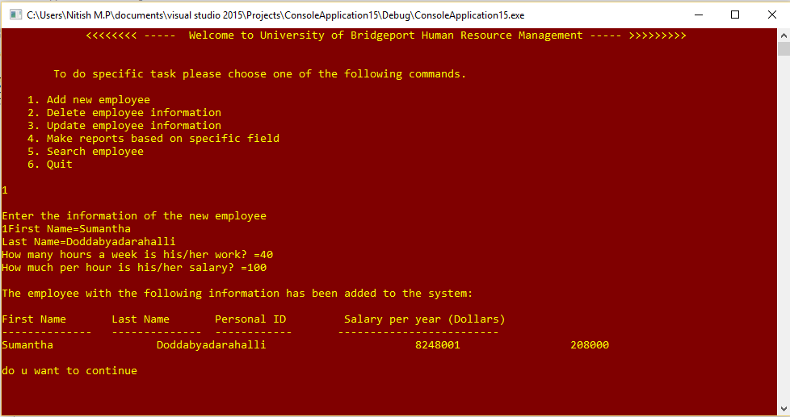
OUTPUT SCREEN SHOT CONT.,

Slide 20
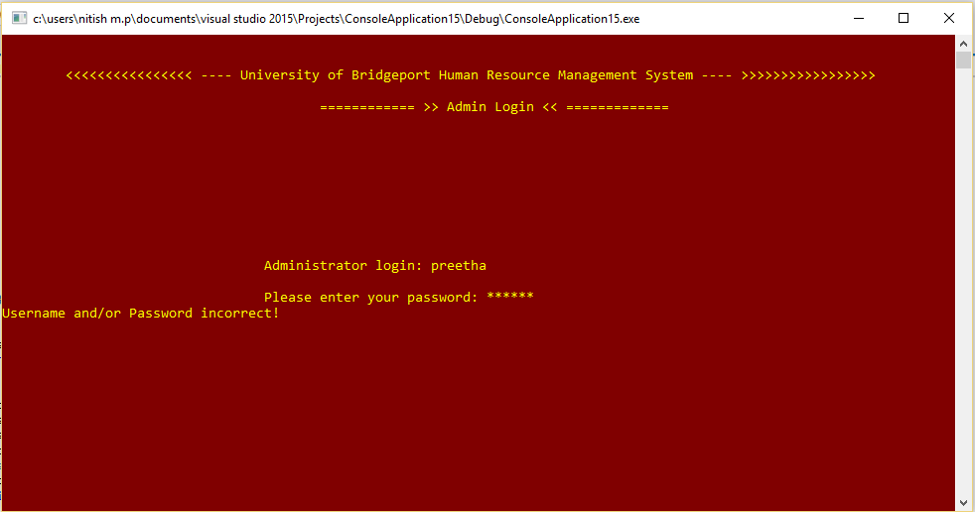
OUTPUT SCREEN SHOT CONT.,

Slide 21
THANK YOU

